Slide 1
Human trafficking identified through situational data

Slide 2
Problem: To help victims we must first detect them
United Nations Office of Drugs and Crime (UNODC) states: Human trafficking has taken on "horrific" dimensions
In the Netherlands, Multiple Systems Estimation (MSE) found that there are four to five times as many victims as those detected

Slide 3
Opportunity: Identify Human Trafficking victims during patient healthcare encounters
Provide information to clinicians for screening patients
Immediately connect to real-time data in order to provide personalized emergency care to Human Trafficking victims
Provide services to victims when identified
including referrals to case management and clinical/societal teams, public health and law authorities per jurisdictional policies and procedures.

Slide 4
Challenge: People in emergency rooms already have a lot on their minds
Each day, new data sources, users, use cases, volume, velocity, variety and veracity of data changes continuously across our healthcare data landscape.
How to quickly identify data at the point of care that is meaningful and personalized enough to drive positive outcomes?

Slide 5
Visible Systems Advantage delivers content within context to healthcare providers
Michael Cesino, President, Visible Systems
Boston based
Team of 6 with 4 engineers
VisibleSystemsCorp.com
For more than 25 years Visible has been providing integrated solutions for building enterprise systems, managing change and enabling business transformation.
We help companies & institutions embed data in every decision and action they take

Slide 6
How we use Starburst Galaxy
Easy to use UI to present data within a workflow
Query data interactively to discover deeper insights
Fully-managed solution designed for organizations of all sizes
Trino MPP SQL engine with Starburst’s enhancements
Federate data from multiple sources
Healthcare Provider Information
FHIR
Visible Systems Data Model & Meta Data
Aggregated Insights on Human Trafficking Probability
Real Time Human Trafficking Personal Information
Data Sources

Slide 7
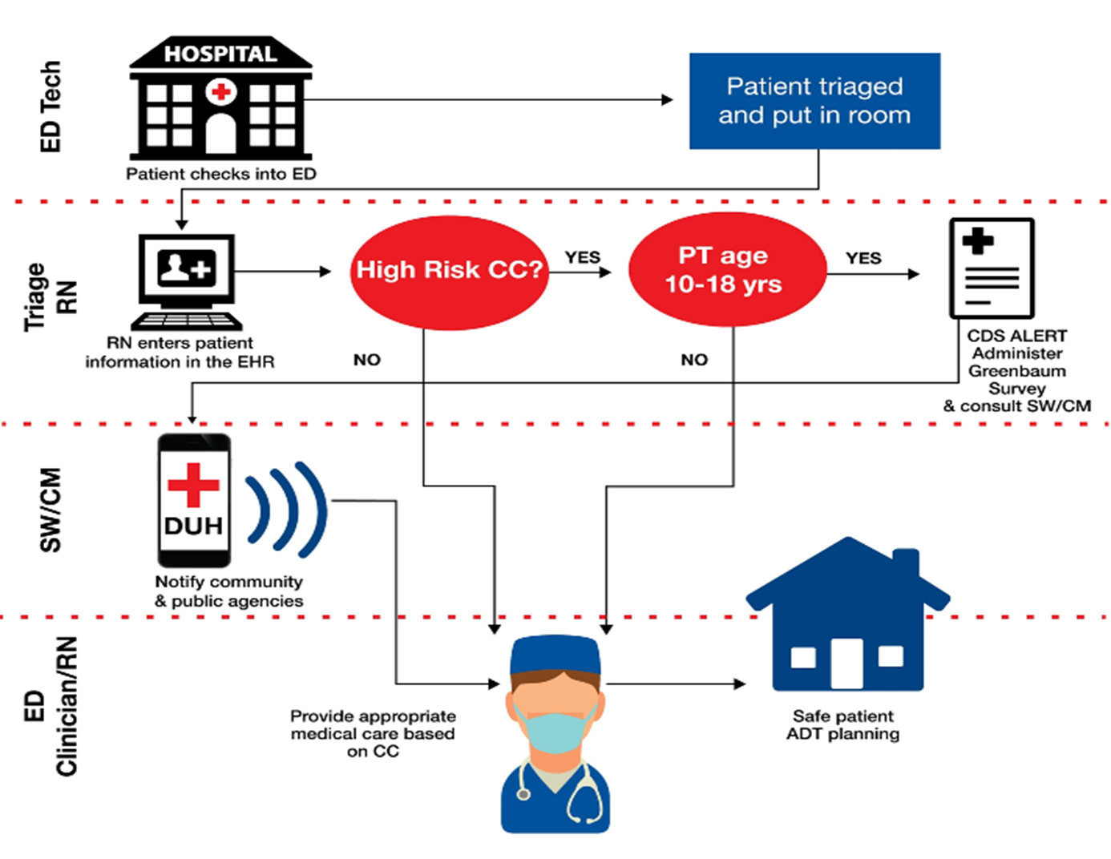
The power of content in context at work
Check into emergency room / urgent care
Triage of medical issue & likelihood of HT victim
3. Administer Greenbaum survey if needed
Notify appropriate community & public agencies
Provide medical assistance
Ensure patient gets discharged into a safe environment

Slide 8
Delivering real life positive outcomes
Step | Data | Next action
1. Check into emergency room / urgent care | Patient name
2. Triage of medical issue & likelihood of HT victim |  | Need to take Greenbaum survey
3. Administer Greenbaum survey if needed
4. Notify appropriate community & public agencies
5. Provide medical assistance
6. Ensure patient gets discharged into a safe environment |  | Handoff to social services

