Slide 1
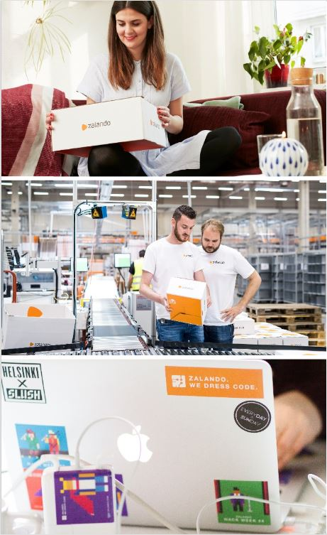
Data Mesh
in Practice
The Zalando Story
Max Schultze
max.schultze@zalando.de
@mcs1408
2021-11-18

Slide 2
Who am I
Max Schultze
Data Engineering Manager
Data Mesh Advocate
Took part in early development of Apache Flink
Retired semi-professional
Magic: the Gathering player

Slide 3
TABLE OF
CONTENTS
Zalando’s Data Platform
What’s this Data Mesh?
Data Mesh in Practice
Notes:
Zalando Analytics Cloud Journey
How did Zalando Data Analytics start
How did it evolve over time, especially in context of the company wide cloud migration
How did Zalando start using Presto as the main analytical query engine
The Evolution of Presto
What is Presto and what are the most common use cases?
How does Starburst fit into the picture and what does it offer on top of Presto?
Advanced Analytical Infrastructure
How did the Zalando Analytical Infrastructure change with the evolution of Presto
How did Starburst get us to the next level?
What are the next steps on the menu?

Slide 4
Zalando’s Data Platform
Notes:
Zalando was found ~11 years ago
Since beginning data driven company
At first starting of with a monolithic backend infrastructure in a datacenter

Slide 5
Zalando’s Data Platform
Ingestion
Serving
Storage
Notes:
Zalando’s Data Lake - three major areas
Ingestion
Data pipelines to load data from most important sources
Storage
Data
Technical and descriptive metadata
Serving
Data Transformation
Data Querying

Slide 6
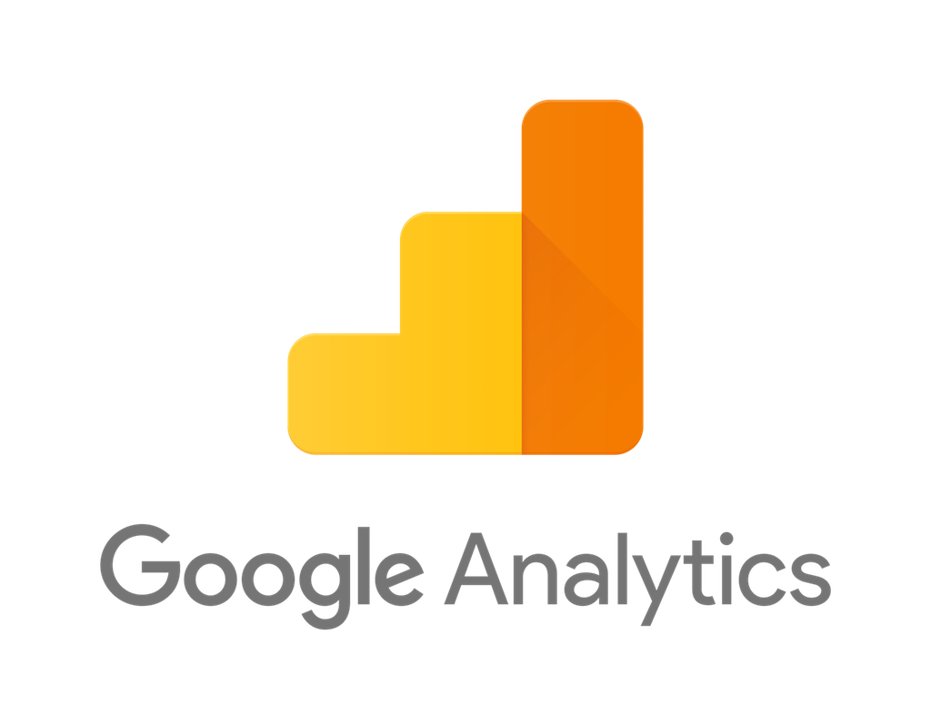
Zalando’s Data Platform
Ingestion
Serving
Event Bus
Storage
DWH
Web Tracking

Slide 7
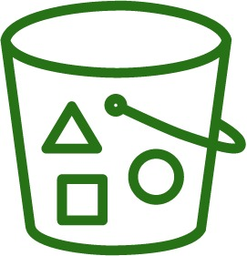
Zalando’s Data Platform
Ingestion
Serving
Event Bus
Storage
DWH
Metastore
Web Tracking

Slide 8
Zalando’s Data Platform
Ingestion
Serving
Fast Query Layer
Event Bus
Storage
DWH
Processing Platform
Metastore
Web Tracking
Data Catalog

Slide 9
Centralization Challenges
Datasets provided by central data infrastructure team
Lack of ownership
?

Slide 10
Centralization Challenges
Datasets provided by central data infrastructure team
Lack of ownership
Data pipelines operated by central data infrastructure team
Lack of quality
 | Field_A | Field_B
Record_1
Record_2
Record_3
Notes:
Table with record quality issues

Slide 11
Centralization Challenges
Datasets provided by central data infrastructure team
Lack of ownership
Data pipelines operated by central data infrastructure team
Lack of quality
Organizational scaling
Central team becomes the bottleneck

Slide 12
A Recurring Pattern
Source domain product teams generating data
Data & ML engineers maintaining the data platform
Teams, decisions makers, data scientists consuming data
Notes:
As a consultant, I have been part of several central data teams, and I know that what Max just described is a very common pattern that I’ve seen again and again
When we take a step back this pattern looks like this
Three general parties ...

Slide 13
A Recurring Pattern
Source domain product teams generating data
Data & ML engineers maintaining the data platform
Teams, decisions makers, data scientists consuming data
Notes:
As a consultant, I have been part of several central data teams, and I know that what Max just described is a very common pattern that I’ve seen again and again
When we take a step back this pattern looks like this
Three general parties ...

Slide 14
A Recurring Pattern
Source domain product teams generating data
Data & ML engineers maintaining the data platform
Teams, decisions makers, data scientists consuming data

Slide 15
A Recurring Pattern
Source domain product teams generating data
Data & ML engineers maintaining the data platform
Teams, decisions makers, data scientists consuming data
Notes:
Firefighting, deal with upstream issues...
Interestingly, doesnt matter whether you’re building a DWH or a Data Lake

Slide 16
Why is that?
central data platform
Notes:
The reason is that this is not a technical problem but it will happen with any central data platform that takes central ownership of data
Simply imagine the number of data producers (left) to grow
And the number of data consumers (right) will grow
UItimately this platform will become a bottleneck
But why is this actually the case

Slide 17
Why is that?
checkout service
checkout events
Notes:
One reason is, that a central data platform is a data monolith that cuts through domains
Let’s say this is a checkout service team producing checkout events

Slide 18
What is Data Mesh?
Data Mesh is...
→ Product Thinking for Data
→ Domain-Driven Design applied to Distributed Data
→ Platform Thinking for Data Infrastructure
→ Federated Governance
Notes:
Now coming from those observations, the data mesh paradigm mainly takes three concepts that we have already been applying successfully in the general SWE community for years, but applies them to data
Those are… and I will quickly go through them now.
And if you haven’t read Zhamak’s article on Martin Fowlers blog yet, do so later today, because she has been the one who coined the term Data Mesh and her article explains the ideas of the data mesh much better than what I can achieve in a few minutes here.

Slide 19
Data as a Product
What “price” is justified?
What is my market?
Data Product
What’s the USP?
What are the desires of my customers?
Are my customers happy?
How to do marketing?
Notes:
Product thinking. I start with this one because I believe that this is really the one that can have the biggest impact, because it helps most with the ownership issues that Max mentioned earlier.
The idea is simple, start thinking of a dataset as a product. That means you have to think about questions such as…
Doing this thoroughly means that you probably need a dedicated data product manager.
The idea is then that such data products are developed and maintained by a cross-functional autonomous team that has all the capabilities to provide their data to their customers. This often means that they maintain data pipelines, interfaces, documentation etc.

Slide 20
Domain-Driven Distributed Architecture… applied to Data
Domain
‹#›
Notes:
Applying domain driven-design here means that one data product should always capture one clearly defined domain
So that the team developing this data product can be domain experts about that domain

Slide 21
Domain-Driven Distributed Architecture… applied to Data
Domain
→ The Data Product is the fundamental building block
Aggregated Domain
‹#›
Notes:
Such domain-oriented data products become the fundamental building blocks of an ecosystem to structure ownership of datasets and value creation
You can think of more source-oriented data products
Or more aggregated data products that consume other data products to form a new domain
An example could be tracking data left and recommendations right

Slide 22
Domain-Driven Distributed Architecture… applied to Data
Domain
→ The Data Product is the fundamental building block
Discoverable
Aggregated Domain
Addressable
Self-describing
Secure (governed by global access control)
Trustworthy
Interoperable (governed by open standard)
Notes:
Now this idea ecosystem of data products has quite some similarity to a microservice architecture
Similarly interoperability is key
But also similarly, not every service counts as a proper microservice

Slide 23
...backed by domain-agnostic self-service data infrastructure
Domain
→ The Data Product is the fundamental building block
Discoverable
Aggregated Domain
Addressable
Self-describing
Secure (governed by global access control)
Trustworthy
Interoperable (governed by open standard)
Data infra engineers
Data Infra as a Platform
Storage, pipeline, catalogue, access control, etc
‹#›
Notes:
Finally one is infra as platform to avoid unnecessary duplication of effort
The key thing here is however, to strictly focus on a data infra platform, not a data platform, means domain-agnostic
Because you need to be very careful not to run into the monolith again (antipattern, domain knowledge needed)
A good indicator for a successful platform can be how long it takes...

Slide 24
Federated Governance
Data Infra as a Platform

Slide 25
Federated Governance
Data Platform Product Owners
Strategic Decision Makers
Data Product Owners
Data Infra as a Platform

Slide 26
What is Data Mesh?
Data Mesh is...
→ Product Thinking for Data
→ Domain-Driven Design applied to Distributed Data
→ Platform Thinking for Data Infrastructure
→ Federated Governance
Notes:
Now coming from those observations, the data mesh paradigm mainly takes three concepts that we have already been applying successfully in the general SWE community for years, but applies them to data
Those are… and I will quickly go through them now.
And if you haven’t read Zhamak’s article on Martin Fowlers blog yet, do so later today, because she has been the one who coined the term Data Mesh and her article explains the ideas of the data mesh much better than what I can achieve in a few minutes here.

Slide 27
What is Data Mesh?
Data Mesh is...
a Mindset Shift
Notes:
Now coming from those observations, the data mesh paradigm mainly takes three concepts that we have already been applying successfully in the general SWE community for years, but applies them to data
Those are… and I will quickly go through them now.
And if you haven’t read Zhamak’s article on Martin Fowlers blog yet, do so later today, because she has been the one who coined the term Data Mesh and her article explains the ideas of the data mesh much better than what I can achieve in a few minutes here.

Slide 28
What is Data Mesh?
Data Mesh is...
a Mindset Shift
Data Mesh is not…
a detailed framework or solution to be implemented
Notes:
Now coming from those observations, the data mesh paradigm mainly takes three concepts that we have already been applying successfully in the general SWE community for years, but applies them to data
Those are… and I will quickly go through them now.
And if you haven’t read Zhamak’s article on Martin Fowlers blog yet, do so later today, because she has been the one who coined the term Data Mesh and her article explains the ideas of the data mesh much better than what I can achieve in a few minutes here.

Slide 29
Data Mesh in Practice
Notes:
...from an infra platform perspective

Slide 30
Data Mesh in Practice
Recap:
From Bottleneck to Infra Platform
Data Infra as a Platform
Storage, pipeline, catalogue, access control, etc

Slide 31
Data Mesh in Practice
Recap:
From Bottleneck to Infra Platform
From Data Monolith to Interoperable Services
Data Infra as a Platform
Storage, pipeline, catalogue, access control, etc
central data platform

Slide 32
Central Services with Global Interoperability
Governance Layer
Data Lake Storage
Notes:
From central catalog by infra team to collibra

Slide 33
Bring Your Own Bucket (BYOB)
Governance Layer
Data Lake Storage

Slide 34
Simplify Data Processing
Governance Layer
Processing Platform
Data Lake Storage

Slide 35
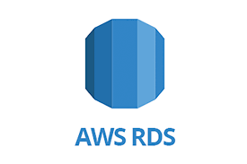
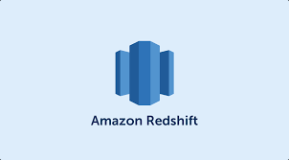
Simplify Data Sharing
Governance Layer
Processing Platform
Data Lake Storage

Slide 36
Central Services with Global Interoperability
Decentralized ownership does not imply decentralized infrastructure!
Interoperability is created through convenient solutions of a self service platform.
Decentral Storage
Central Infrastructure
Decentral Ownership
Central Governance

Slide 37
Data Mesh in Practice
Recap:
Datasets provided by central data infrastructure team
Lack of ownership
?

Slide 38
How to Ensure Data Quality?
Make conscious decisions
Opt-in instead of default storage

Slide 39
How to Ensure Data Quality?
Make conscious decisions
Opt-in instead of default storage
Behavioral changes - data is a product

Slide 40
Care About Your User!
Classification of Usage

Slide 41
Care About Your User!
Classification of Usage
Dedicate resources to
Understand usage
Ensure quality

Slide 42
Some Numbers

Slide 43
Some Numbers
>70 teams using BYOB

Slide 44
Some Numbers
>70 teams using BYOB
~1000 distributed query engine users

Slide 45
Some Numbers
>70 teams using BYOB
~1000 distributed query engine users
First curated data teams
Data Products
On Data Products
On Data Products

Slide 46
Some Numbers
>70 teams using BYOB
~1000 distributed query engine users
First curated data teams
0 operational effort for the central team
Data Products
On Data Products
On Data Products

Slide 47
Some Numbers
>70 teams using BYOB
~1000 distributed query engine users
First curated data teams
0 operational effort for the central team
Data Products
On Data Products
On Data Products
It’s a journey ;)

Slide 48
It’s a Journey

Slide 49
“Off the shelf” data tooling

Slide 50
“Off the shelf” data tooling
De-centralized archiving

Slide 51
“Off the shelf” data tooling
De-centralized archiving
De-centralized GDPR deletion tooling

Slide 52
“Off the shelf” data tooling
De-centralized archiving
De-centralized GDPR deletion tooling
Template driven data preparation

Slide 53
Data Mesh
in Practice
The Zalando Story
Max Schultze
max.schultze@zalando.de
@mcs1408

