Slide 1
Rewriting History
Migrating petabytes of data to Apache Iceberg using Trino
Marc Laforet
Senior Data Engineer @ Shopify
Notes:
Hi everyone and welcome to the afternoon sessions of the trino summit. Im Marc and my session will explore shopify’s journey migrating our data lake to the iceberg table format and here is the best iceberg shaped bunny i could find on the internet.

Slide 2
whoami
📍Toronto, Canada
📊 Worked in data space for ~ 6 years
🏊 Swim in my free time
Notes:
Here’s a little who am i, I imagine we might be a little pressed for time so lets just skip through this.

Slide 3
1
Problem statement
2
Why Iceberg
3
Migration strategies
4
Trino’s Iceberg integration
5
Benchmarks
6
Reflections
Notes:
Here’s the agenda for this session. I’ll start by building context for what the data lake looked like at shopify, outlining some problems we were/ sadly still are facing. I’ll give a brief overview of iceberg and how we think it will help us. I’ll go over migration strategies to consider if you find yourself in a similar situation. Im personally pretty satisfied with the current trino/iceberg integration but that wasn’t always the case. In this section I’ll go over some open source contributions made that were crucial in our pursuit of using trino to migrate datasets to iceberg. I’ll then round out the talk with some benchmarks and finish with some reflections on this migration project.

Slide 4
1
Problem statement
2
__________________________Why Iceberg
______________________Migration strategy
3
4
________________Trinos Iceberg integration
__________________________Benchmarks
5
6
___________________________Reflections
Notes:
Undergo the

Slide 5
Lakehouse Team
Ingest 1st party data
Storage and retrieval of 1st party data
Notes:
I’ll start to build context by giving a peak into the organizational structure that caused this migration project to land onto my plate. Im on Shopify’s lakehouse team. This team has 2 genrealized mandates, one being to ingest all of shopify’s 1st party data and another to optimize that data’s storage and retrieval. I focus most of my time on the team’s second mandate

Slide 6
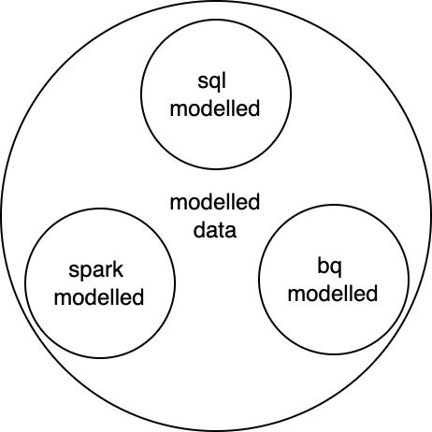
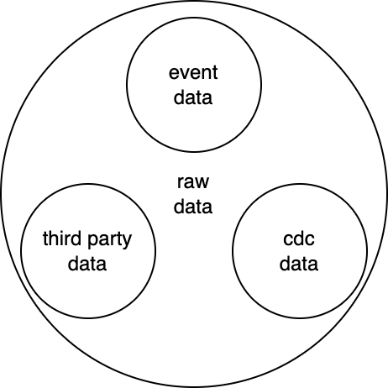
Lakehouse Datasets
Notes:
If we take a look at the datasets being stored in the lakehouse, our teams responsibility was to historically scoped to first party data which we stored as hive tables. It’s probably obvious but this first party data is only the start of the data lineage, datasets modelled off these assets comprise a significant component of shopify’s valuable data. Shopify’s data platform built in-house tools to facilitate the major modelling workflows and unfortunately the table format employed by these tools was left up to the teams themselves. This lead to each tool adopting a different table format, maybe that’s hive, maybe they leveraged a proprietary data format or even worse maybe they invented their own.

Slide 7
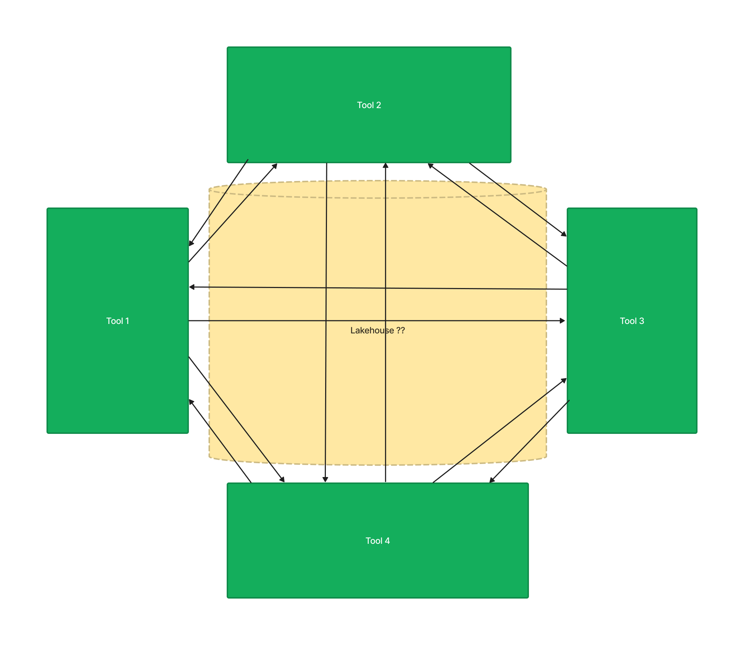
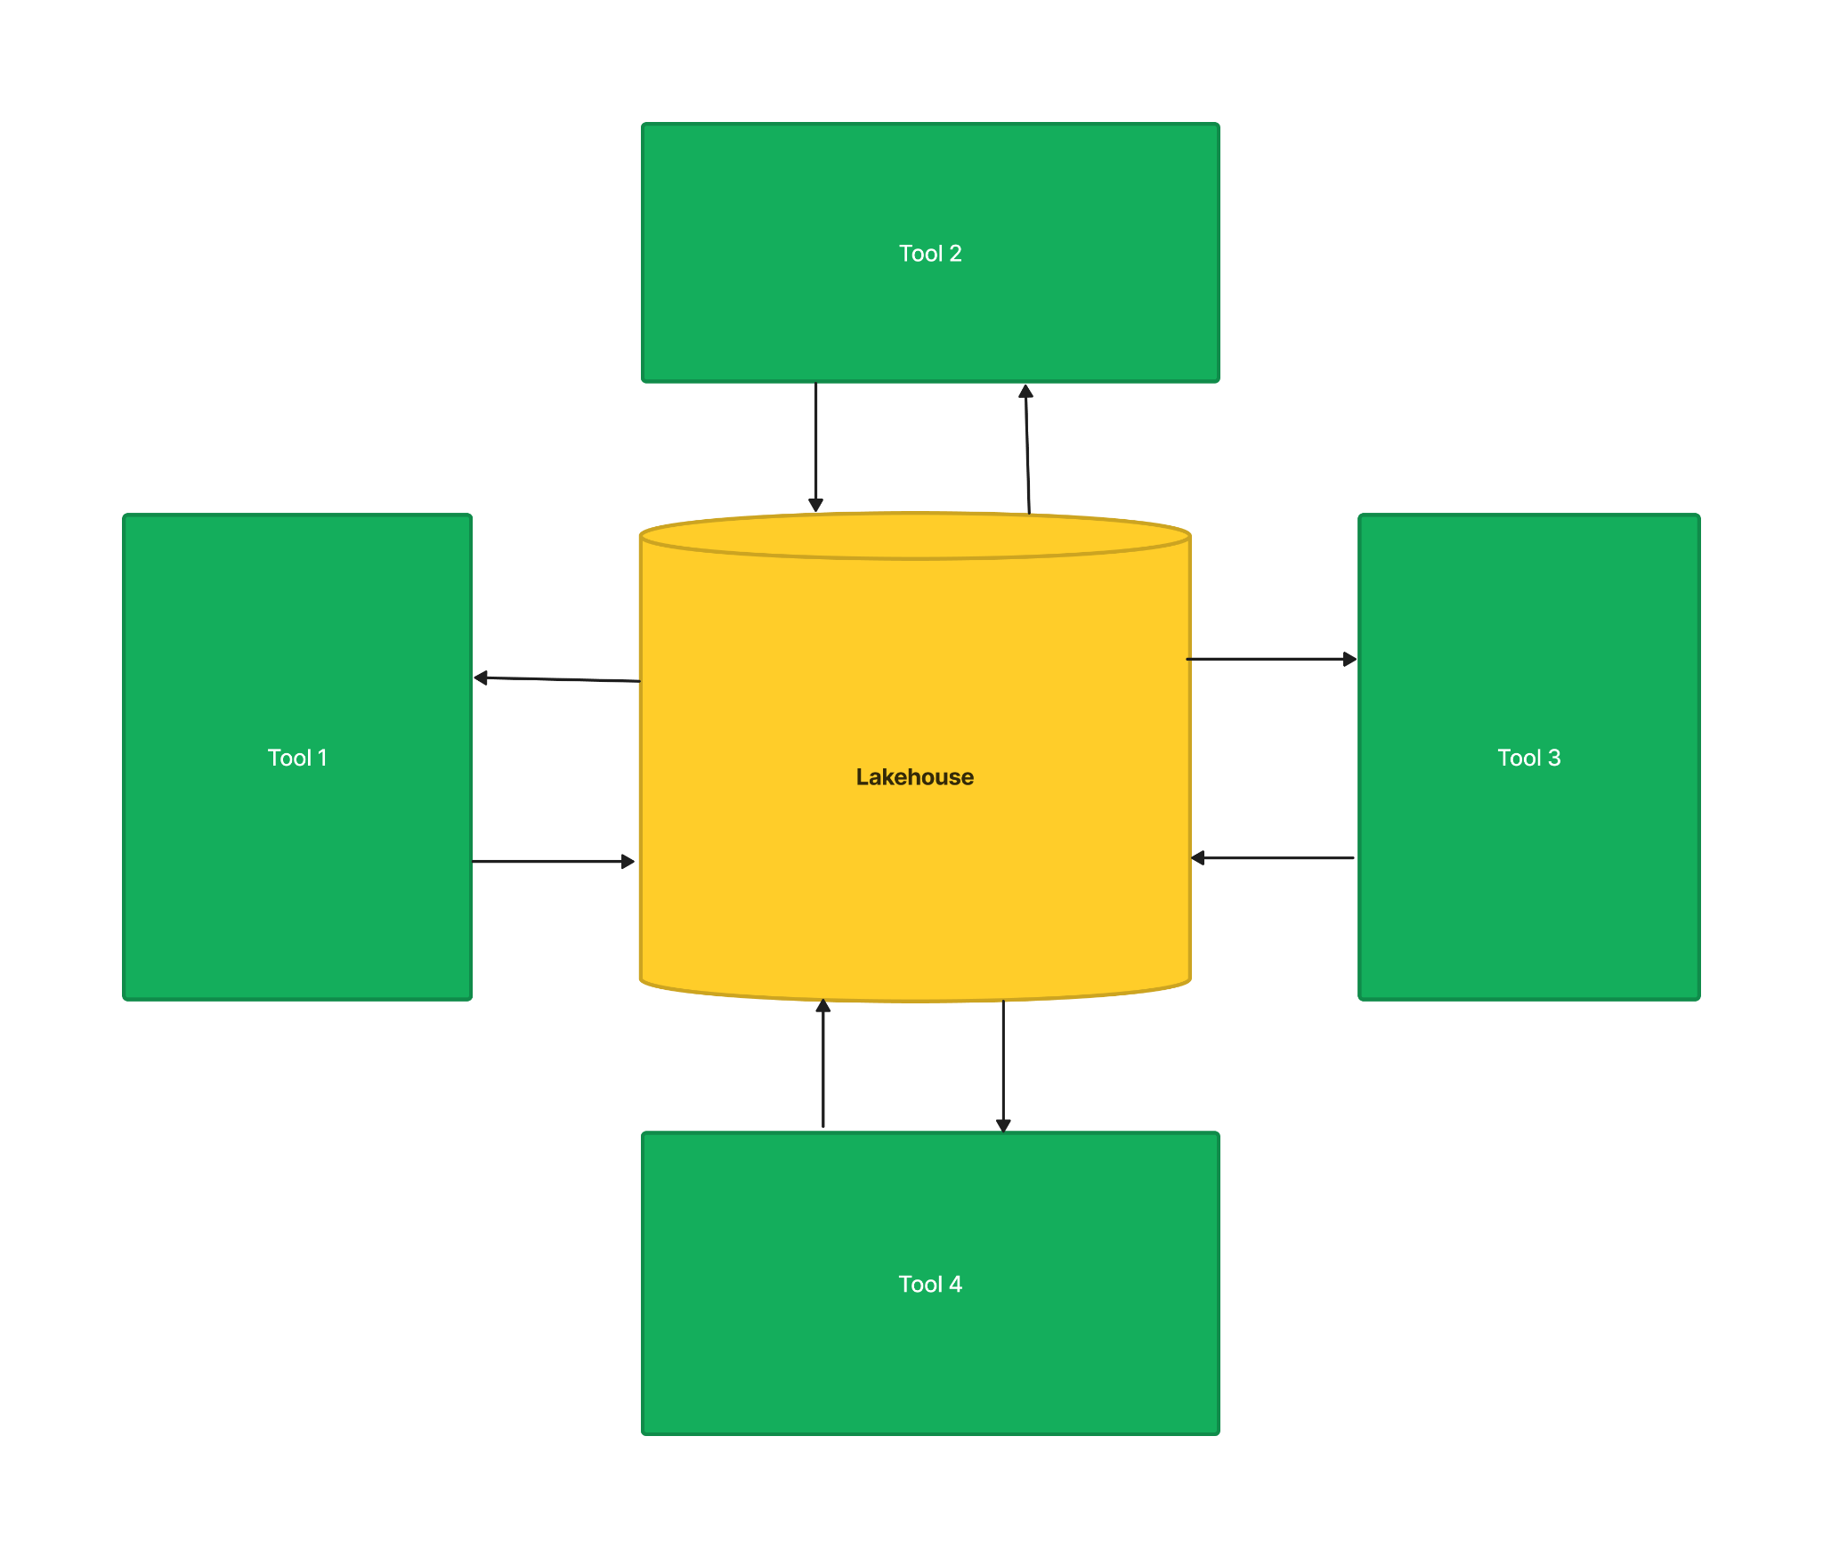
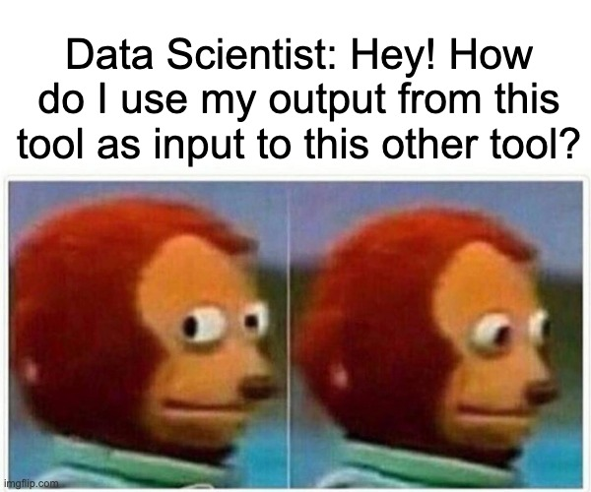
Lakehouse Architecture
Notes:
As you might imagine, this architecture quickly divulged into chaos. At best, spinning up a new tool required implementing custom interfaces to accommodate dataset formats and at worst the tools had their abstracted representation of a table baked into their codebase making very expensive tech debt. This caused intense friction between data platform components, killing the interoperality of datasets and resulting in really unhappy data scientists. You know this makes sense, I know i would be frustrated and its not like this was an intended design or outcome. We simply slept walked into it during a time where moving quickly was more valuable. It’s probably obvious that the preferred architecture would be for all tools reading and writing to the lakehouse should share the same table format. So why not anchor on hive tables? It’s not like our hive tables are perfect, a lot of our hive tables are thin layers on poorly written tables to being with. If we are going to make the effort to improve then why don’t we bring our tables to current/emerging industry standards.

Slide 9
Open Table Formats
Libraries that keep track of files making up a table
File system
Hard Drive
Iceberg
Object Storage
Notes:
These new age table formats offer more efficient retrieval, out of the box maintenance procedures like file compaction and clean-up, hidden partitioning or partition evolution and merge on read and more. A colleague of mine came up with this analogy I find really useful. Your hard drive physically stores your data but your file system provides the abstraction to retrieve information from the disk into the container of a file. Open tables formats provide a similar abstraction onto a cloud object store. The object store contains the files, and the table format provides the abstraction of a table onto it.

Slide 10
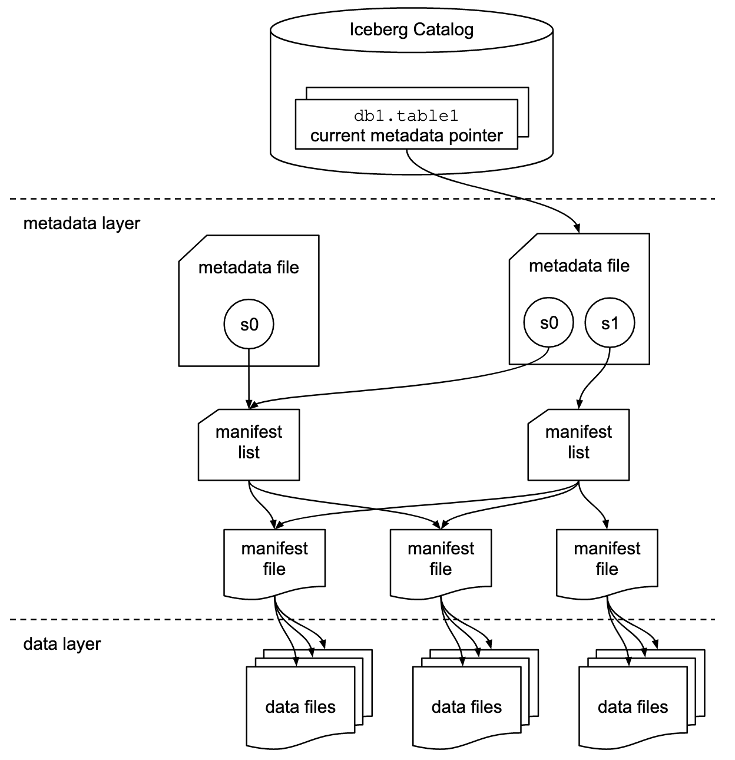
Iceberg
Notes:
I’d be remiss if i didnt include the iceberg specification which depicts how the metadata layers are used to track data files comprising a table. At the time of choosing between the popular open table formats, delta lake was tightly coupled to the databricks vendor and iceberg had a specification published making it easier to implement into different engines. What i think trips people up is that even when choosing iceberg as a table format, it doesnt allow you to deprecate all your hive infra. As i said Iceberg is a library, there is no deployed infrastructure. You still require deploying a metastore to store table information, commonly the hive metastore is deployed although I hope to see this shift over the next couple years.

Slide 11
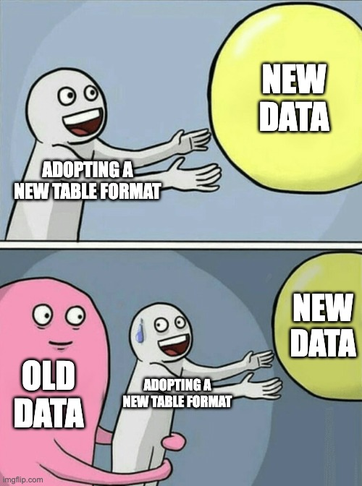
Notes:
Green field projects can use iceberg as the de facto table standard, removing the need to build all the boiler plat adaptors, but you have still have all your historical data preventing you from making a clean break. Migrating these datasets is really daughting. Not only do you need to schedule all the tech debt work of upgrading the tools but you physically have to create iceberg tables from your old datasets.

Slide 12
Lakehouse Datasets
Notes:
Remember all this.

Slide 13
Migration Strategies
Current State | Strategy
Data is not in a supported file format | Rewrite everything
Data is in a supported file format but you want to change the partioning strategy | Rewrite everything
Data is in a supported file format and properly partitioned | Generate manifest files only
Notes:
Iceberg supports more limited, or standardized, file formats. It supports parquet, orc or avro. If you’re current tables data is not written in a supported file format than you will have to re-write all your data.
Lets say that your data is in an approved file format but you want to change the partitioning strategy, well you will have to rewrite everything. You may be interested in registering a the metadata layer, adding the partition spec and then triggering a rewrite data files action, but if you are expecting a significant amount of data to be rewritten then it might be better to have more control… i digress.
If you’re data is in the proper file format and partitioned properly then you can avoid the expensive operations of re-writing your data and just generate the manifest files. Iceberg 0.14.0 released some out of the box procedures to help with this but unfortunately i think they are only available in spark atm. Additionally, those procedures only work for tables that are currently being stored as hive tables.
If your like us you might find yourself in a position where you need to re-write your fil. IE full rewrites

Slide 14
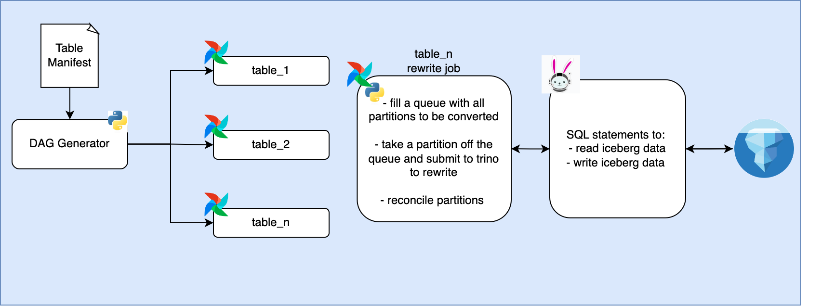
System Design
Notes:
Here’s the system we built to migrate datasets. A python script takes in a manifest file listing tables to be migrated and outputs a dag per table. This DAG, which is a single kubernetes pod operator, coordinate’s the migration process for the dataset. The k8s pod operator runs a python program that first selects the partitions in the old dataset that arent in the migrated dataset. It loads these ‘missing’ partitions into a queue and then submits migrations to be completed partition wise. After migrating a partition it reconciles the new and old datasets and then tracks the progress in a migration progress table.
Now this is all well and good but i have admit something, we naively designed this workflow without first checking trino-iceberg integration. Cliffhanger…

Slide 15
1
Problem statement
2
Why Iceberg
Migration strategy
3
4
Trinos Iceberg integration
__________________________Benchmarks
5
6
___________________________Reflections
Notes:
Trino’s iceberg connector was added in trino version 341 on september 8th 2020. One thing that was really cool was that our project kind of grew along side trino’s iceberg integration, there were walls that we hit that were patched by the trino community within a couple weeks. The next section of this talk will go over some of the crucial trino-iceberg contributions that made our this project possible.

Slide 16
Iceberg tables partitioned on timestamp with time zone
Notes:
The first contribution is one that was completed before we started out on our migration journey. Remember that we are talking about migrating raw event data. Streaming these events in, its very common to partition on a timestamp field and our timestamps have time zone information.

Slide 17
Unknown type: class io.trino.spi.type.LongTimestampWithTimeZone java.lang.IllegalArgumentException:
Unknown type: class io.trino.spi.type.LongTimestampWithTimeZone
Notes:
When you tried to do this before you would get an unknown type exception when you tried to query data stored in this partition format.

Slide 18
PR-9757
Return timestamp time zone partitions in UTC
Notes:
This was patched by Piotr Findeisen in PR-9757 and released in trino verson 364

Slide 19
Scale Iceberg Writes
Notes:
The first trino-iceberg limitation that we hit was when we tried to scale our iceberg writes. Some of our tables are huge and sequentially migrating topics would have taken months. The obvious way to scale the writes was to add concurrency. We added concurrency into the python program here.

Slide 20
org.apache.iceberg.exceptions.CommitFailedException:
Metadata location [<bucket-name>/<namespace>/<table-name>/metadata/203942-8936d432-7ef0-4bfe-8098-bf9ca06580fe.metadata.json] is not same as table metadata location [<bucket-name>/<namespace>/<table-name>/metadata/203943-cf4a6194-1ee7-4483-846c-f495ab237e78.metadata.json] for <namespace>.<table_name>
Notes:
When we did this we received a bunch of CommitFailedException errors from iceberg.

Slide 21
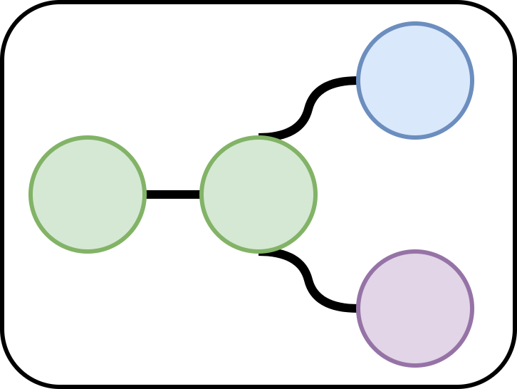
Notes:
Recall the snapshot model that iceberg introduces, It uses the current snapshot-id and then adds the next ‘commit’ on top of it. Iceberg operates under an assumption of optimistic concurrency and we have entered a race condition

Slide 22
Notes:
One of processes succedes and adds its commit onto the table. The next commit then tries to commit and it fails producing the error message i just showed. The problem is that the commit’s metadata files reference the middle snapshot id where it needs to reference the new commit. So this is kind of good news b/c it means that we don’t have to redo the expensive data rewrite process and can simply rewrite metadata.

Slide 23
Notes:
So this is kind of good news b/c it means that we don’t have to redo the expensive data rewrite process and can simply rewrite metadata.

Slide 24
PR-11886
Throw proper error to make use of iceberg’s commit retries
Notes:
What’s really nice is that this was patched by Alex Jo on May 16th and released in trino 379.

Slide 25
Missing File Problem
Notes:
So now we can scale our migration process. The next error is something that anyone working with iceberg will likely be familiar with and that’s the missing file problem.

Slide 26
org.apache.iceberg.exceptions.NotFoundException:
Failed to open input stream for file: [<bucket-name>/<namespace>/<table-name>/metadata/snap-8501054657342128291-2-8eeb7ee8-54c7-4e08-a2db-f5cbdd855835.avro
Notes:
There’s a couple different reasons that this can happen. Thinking of the system architecture there are quite a bit of technologies at play here, theres GCS, a hive metastore, trino and our airflow orchestrated python process. All these processes talk together over network. As I said, you can run into this for a myriad of reasons but essentially what happens is one of processes proactively cleans up after itself trying to be a good citizen if it thinks that one of its jobs failed. Our team built a fail safe for this generalized error, we have object versioning setup on our buckets with configurable retention, meaning that deleted files can be recovered. A repair task traverses the metadata tree and recovers any referenced files that have been deleted.

Slide 27
PR-14118
Avoid pro-active file cleanup on HMS time-out
Notes:
Although we had our failsafe, the open source community has yet again come to the rescue. Findinpath - Marius Grama threw the proper exception in trino so that the iceberg library won’t proactively clean up files. This change was merged on September 16th and released in trino 397

Slide 28
1
Problem statement
2
Why Iceberg
Migration strategy
3
4
Trinos Iceberg integration
Benchmarks
5
6
___________________________Reflections
Notes:
Now that we’ve gone over the trino-iceberg integration lets look at some benchmarks of some migrated tables.

Slide 29
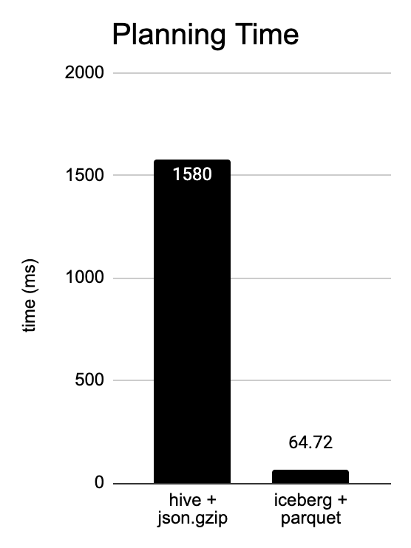
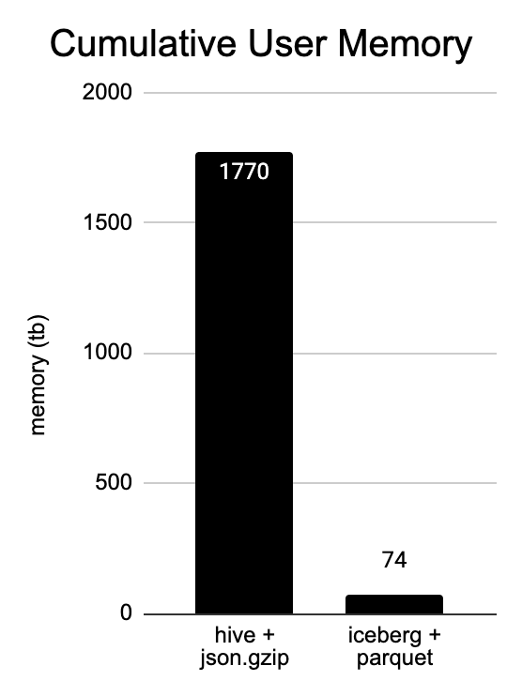
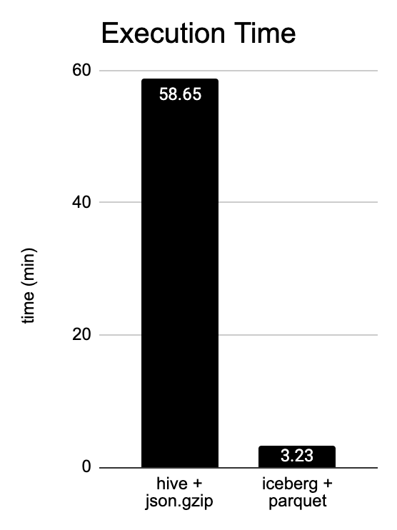
Benchmarks
Notes:
Checkouts table, 153 TB, 60 n2-standard-64 workers, running simple select with minor filters.
25X, 24X, 20X

Slide 30
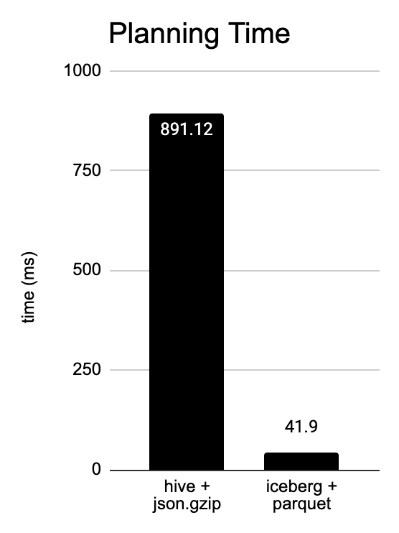
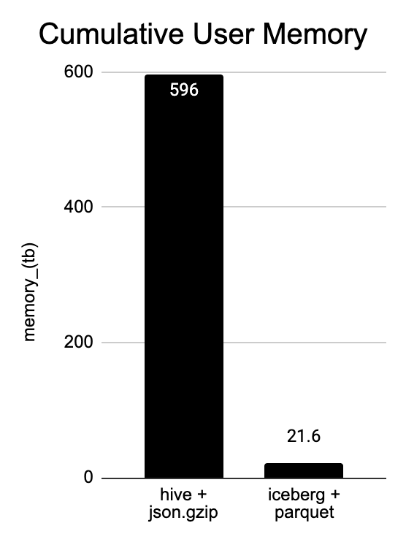
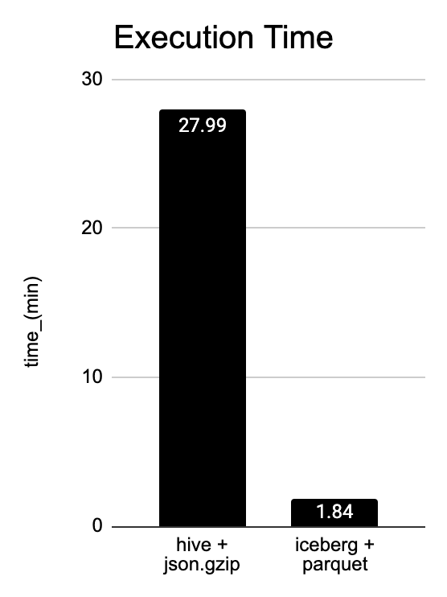
Benchmarks
Notes:
Checkouts table, 153 TB, 60 workers, ordering shops by most checkouts in the past month
21X, 28X, 15X

Slide 31
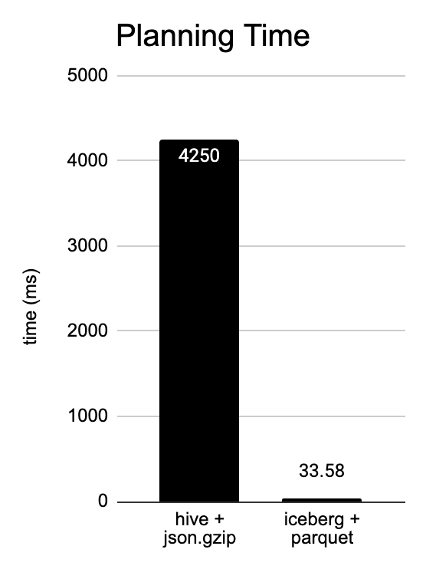
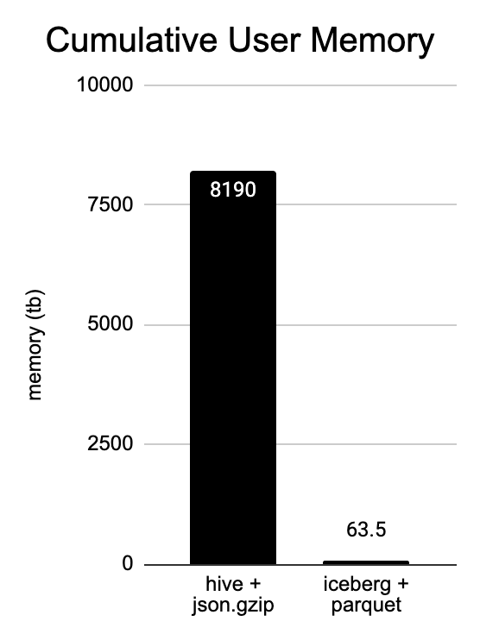
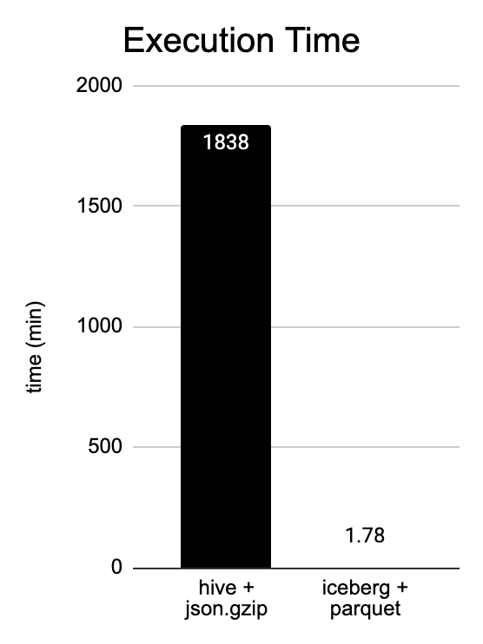
Benchmarks
Notes:
shopify_api_query, 1.5 PB, 80 workers, getting most popular schema’s in past month
128X, 128X, 1000X

Slide 32
Reflections & Advice
Using a modern table and file format can really improve query performance
Huge benefit using open source software
Write new and old data to the same table
Construct a migration priority list
Airflow offered nice out of the box task scheduling but wasn’t great at managing long-running tasks
Notes:
Finally lets cover some reflections on the project.

Slide 33
Project Contributors
Sam Wheating
Victoria
Bukta

Slide 35
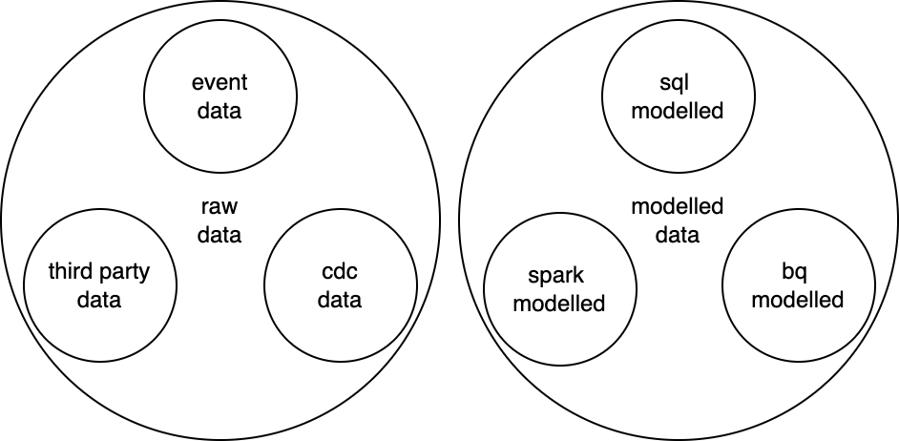
The Iceberg Lakehouse
Notes:
The dream

Slide 36
Notes:
all the different components invented their own table formats, made the components unable to talk to each other. You couldn’t seamlessly move between different tools. Created a lot of friction.

Slide 37
How many table formats are in use?
Hive Tables
Proprietary Table Formats
Custom Table Formats
Standard hive tables
Synthetic partition key column
Columnar data being stored in json.gzip format
Datasets migrated into bigquery
Teams invented their own table formats for their tool
No ACID properties
Full drop every time
Notes:
Take this slide out and just talk about it when slide before is on the screen

Slide 38
Dynamic Writer Scaling
https://github.com/trinodb/trino/pull/10614
Notes:
Might take out
Not 100% sure if this is related to Franklyn’s change
https://github.com/trinodb/trino/pull/12261/files

Slide 39
File pruning using table statistics
https://github.com/trinodb/trino/pull/9326
https://github.com/trinodb/trino/issues/4115

Slide 40
Stitching with a view
https://github.com/trinodb/trino/pull/8621
https://github.com/trinodb/trino/pull/8540

Slide 41
Utilities
https://github.com/trinodb/trino/pull/10480 (vicky)
https://github.com/trinodb/trino/pull/10459 (austen)

Slide 42
Monitoring
https://github.com/trinodb/trino/pull/12026 - update
https://github.com/trinodb/trino/issues/7933 - merge

